Slide 1

Super Luigi Bros.
Audrina, Edwin, Brady

Slide 2

Our Project
Our group made a Super Mario type game where Luigi is the playable character.
Super Luigi Bros is intended for players who enjoy the classic Mario platformer experience but with Luigi as the main character.

Slide 3

Functional Requirements
Character Control
Define Luigi's movements and controls
Ensure responsive and precise character physics
Level Design
Create diverse and challenging levels, with unique layouts, themes, and difficulty progression
Enemies and AI
Design varied enemy types with distinct behaviors
Game Mechanics
Include platformer-specific mechanics, like wall jumping, moving platforms, switches, warp pipes, etc.
User Interface (UI)
Design a user-friendly and visually appealing UI, including menus score displays, and heads-up displays

Slide 4
Non-Functional Requirements
Performance
Response Time: The game should provide responsive controls with minimal input lag
Framerate: Achieve a consistent and smooth framerate for an enjoyable experience
Compatibility
Ensure compatibility with a wide range of screen resolutions and hardware configurations
Usability
Design an intuitive and user-friendly interface for players of all skill levels
Reliability
Game should be stable and not crash or hang during gameplay

Slide 5

Dependencies
Third-Party Libraries
Dependence on third-party libraries like Pygame for specific functionalities, such as physics engines, audio libraries, or asset management tools
External Art Assets
Dependencies on external art sources for creating character sprites, level backgrounds, and other visual assets unique to the Mario theme
Sound Design Services
Dependence on sounds similar to what is found in already existing Mario games of the established intellectual property (IP)
Licensing
Our game is based on the widely popular Mario franchise created by Nintendo, so external licensing rights for using their IP is required from a professional perspective

Slide 6
Stakeholders
Primary Stakeholders
Game Developers/Programmers: The team responsible for coding and development of our game
Secondary Stakeholders
Players/Gamers: Casual players or dedicated gamers who enjoy platformer games or just want a familiar Mario-like experience
Investors: Financial supporters who are responsible for funding the development

Slide 7
Tools Used
Trello
Project Management
GitHub
Game code
OneDrive
File sharing
LucidChart
Diagrams

Slide 8
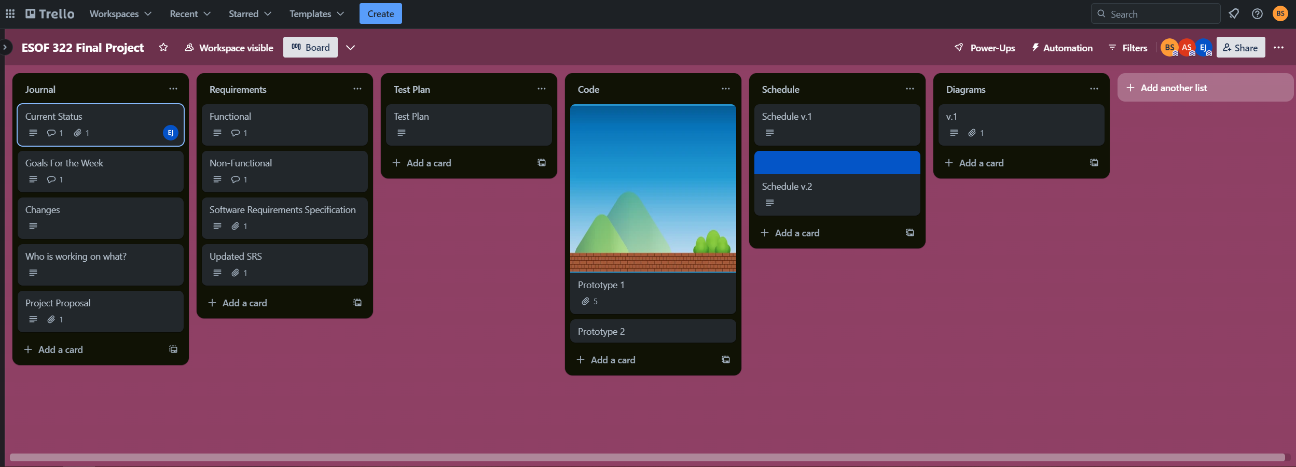

Slide 9
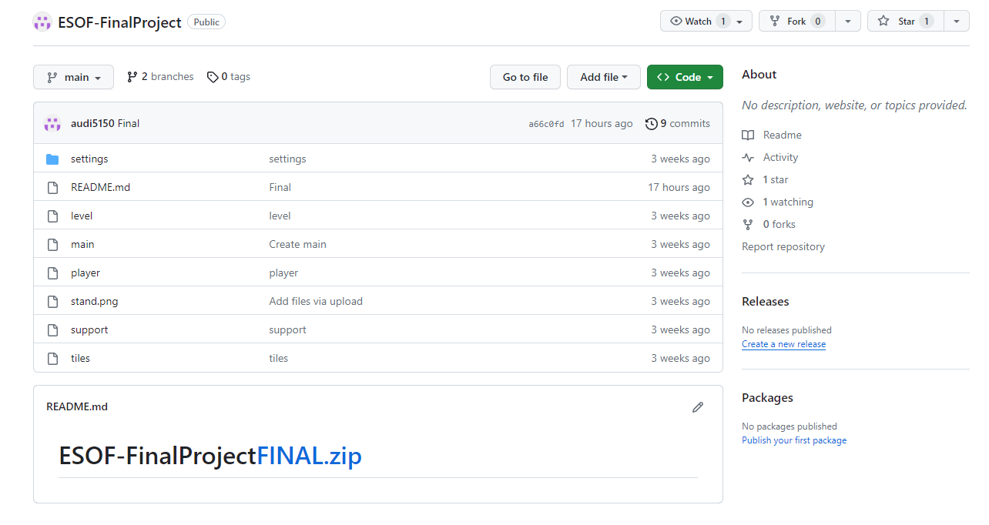

Slide 10

Test Plan
The game was tested by us. As more features were added, it was played to make sure everything worked (at least somewhat).
With more time, we could have other people playtest to see if they have any ideas that we didn't think of.

Slide 11

Process
Incrementally developed.
Sprite sheets and some code from other sources used.
Focused on basic functionality (moving, jumping, level scrolling) first.
Created some additional levels later.

Slide 12
Challenges
None of us have used PyGame before.
Collision detection took a bit longer to get implemented than anticipated.
Bugs remain. Fixing them would take a considerable amount of time.

Slide 13
Changes
As development went on, some features had to be excluded due to time constraints.
Power ups, grabbing turtle shells, death animation, are some examples.
As a result, the appropriate changes were made to the SRS and the schedule.
Overall, the schedule and the SRS did not change all that much. Most of the nice to haves that we didn’t get to would still be nice to implement in the future.

Slide 14
Reliability/Dependability
Overall, the reliability and dependability of the game is not great, but that is once again due to time constraints. It is very difficult to make a fully functioning game in such a short time, especially in college where there are other assignments and projects to complete.
As a result, the game may crash at times and will not always work as expected.

Slide 15

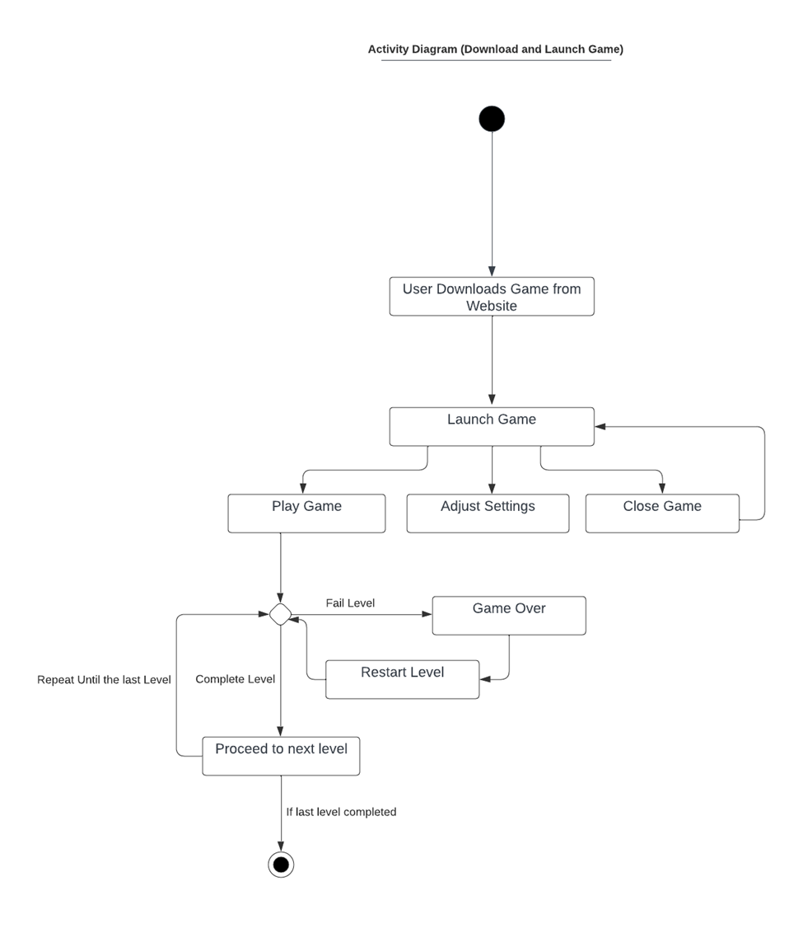

Slide 16
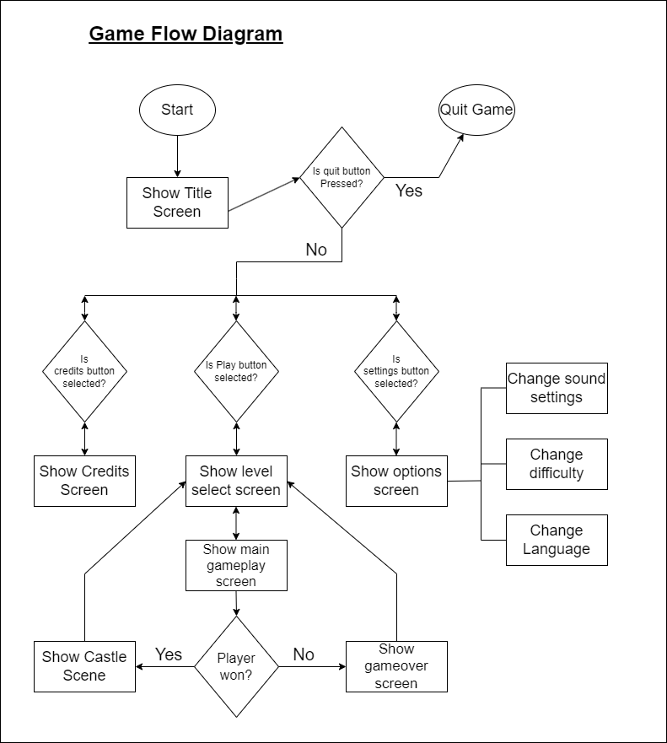

Slide 17
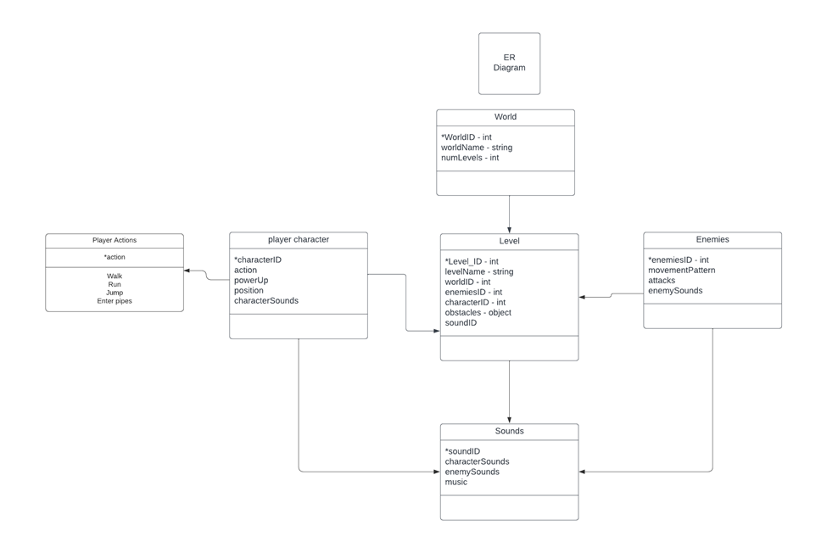

Slide 18
